Slide 1
European Data Portal
Activities in a nutshell

Slide 2
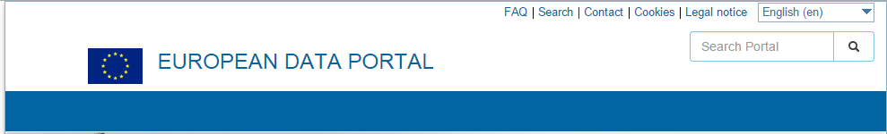

The European Data Portal - What do we do?
“We harvest open data made available by all public administrations across Europe.
Our focus is data from the Member States”
  We offer metadata in 9 languages (for now), we visualise, we offer quality checks for over 450K datasets
  We train a suite of learning experiences in the field of Open Data from publishing to the re-using Open Data
  We showcase Open Data events, Open Data news, Open Data best practices, Open Data reports, etc
  We collect by inviting stakeholders to share their stories, their feedback, their portals
  We convene: meetings, webinars, events to discuss open data best practices, challenges and next steps
  We share our source code and promote open source and re-use of components and standards

Slide 3
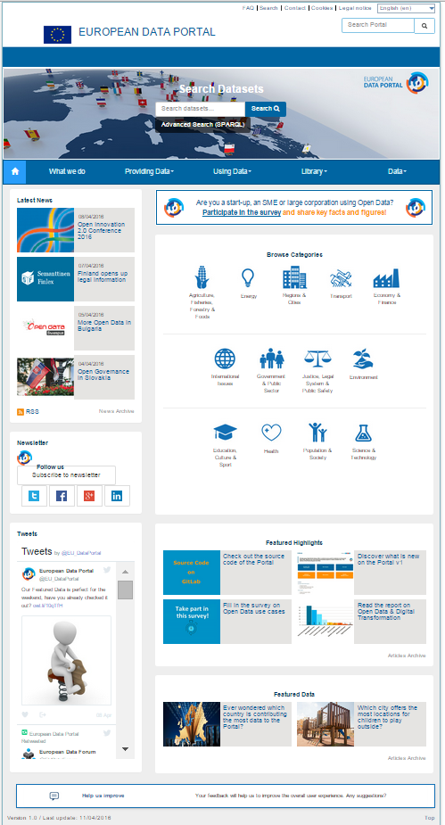
www.europeandataportal.eu
Launched on 16 November 2015
+450 K metadata sets
34 countries covered
71 catalogues
13 categories to structure metadata
Metadata quality assessments
9 languages for static content: FR, DE, EN, ES, PL, IT, NL, SV, SK
Visualisations & maps applications
A Goldbook for data holders
Training and eLearning material
A library with learning material, re-use examples, presentations
Featured highlights & featured data
Weekly Open Data news
The European Data Portal is a central hub providing access to all the information (metadata) about the data made accessible throughout Europe

Slide 4

Multiple Learning experiences brought online
A Goldbook for data providers
eLearning Modules
Library
Open Data in a Nutshell
Step 1: Introduction to Open Data
Step 2: Open Data Implementation
Step 3: Technical deep dive
Step 4: Where next with Open Data?
Economic analysis
Landscaping report
Use cases
Further training material
Country specific reports
How to build an Open Data Strategy
Technical preparation & implementation
Training Companion
Putting in place an Open Data lifecycle
Practicalities to run own Open Data workshops
Ensuring and monitoring success
Online learning is complemented by tailored support to countries

Slide 5
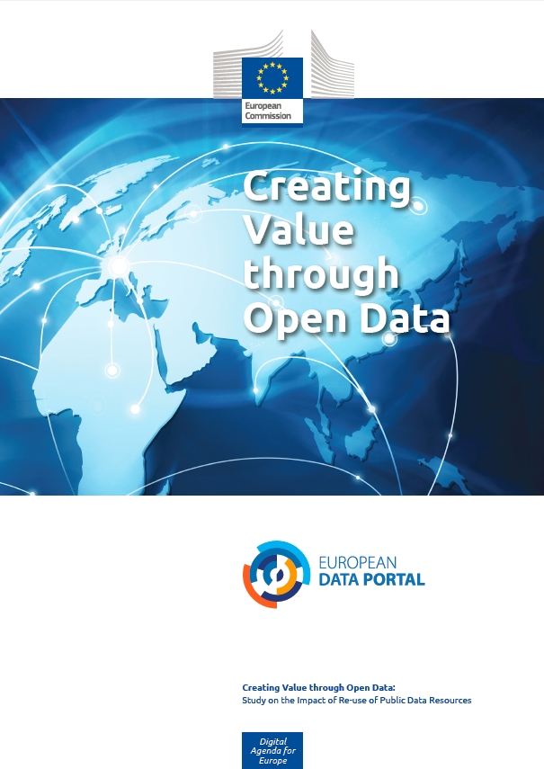
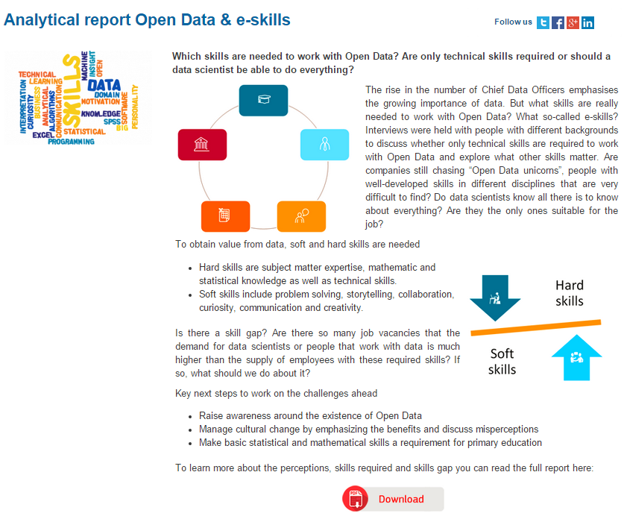
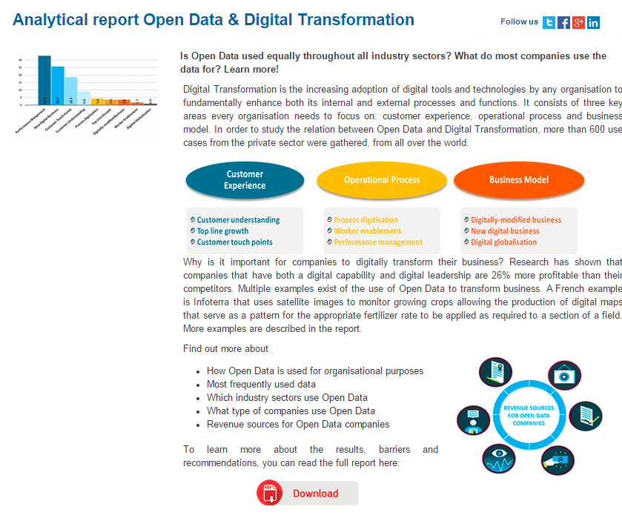
The European Data Portal also aims at fostering the reuse of public data resources
Economic Benefits of Open Data
Metrics to measure economic impact
Market Size
Jobs Created
Cost Savings
Efficiency Gains
Study published on www.europeandataportal.eu
Community Engagement
Reports to drive understanding and reuse
Topic 1: Open Data and Digital Transformation
Topic 2: Open Data and eSkills
Topic 3: Open Data and Cities (April 2016)
Topic 4: Open Data and Privacy (May 2016)
Workshops to drive understanding and reuse

Slide 6
Understanding the harvesting architecture of the European Data Portal
The harvesting architecture of the portal consist of two sides
  CKAN is used as the central metadata repository for storing
  Browsing and searching datasets in a POSTGRES relational database.
The Harvester is a separate component, able to harvest data from multiple data sources with different formats and APIs
Metadata gets harvested, transformed into the CKAN JSON schema and pushed into the CKAN repository.
Gazetteer component is used by the Harvester to enhance the metadata with geo-spatial data and information, mainly to improve the search functionality.

Slide 7
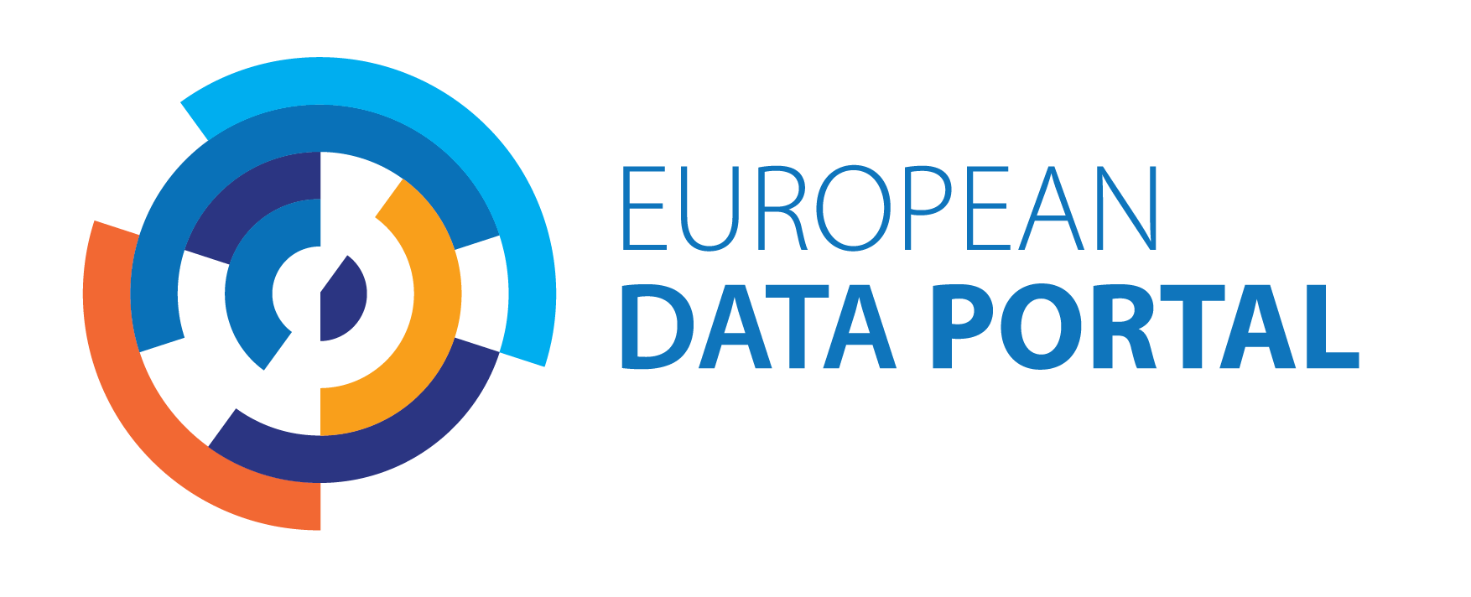
Go and try it out.
www.europeandataportal.eu

