Slide 1
The EU’s commitment to data sharing
SUPPORT CENTRE
FOR DATA SHARING
data.overheid.nl user forum, 5 November 2020
Gianfranco Cecconi
EU Support Centre for Data Sharing
@EU_DataSharing
Funded by the European Union SMART 2018/1009

Slide 2
personal data
public sector information (PSI)
WE ARE HERE
open data
“free flow” of non-personal data
information policy
data sharing
crowdsourced data
decentralised data
data ethics
AI
… WE ARE GOING THERE
security
© Adam Evans - M31, the Andromeda Galaxy (now with h-alpha) https://commons.wikimedia.org/w/index.php?curid=12654493

Slide 3
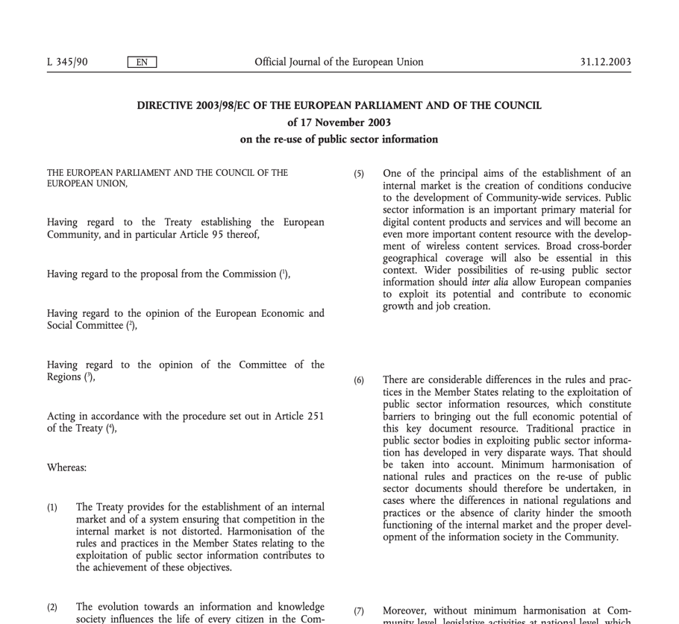
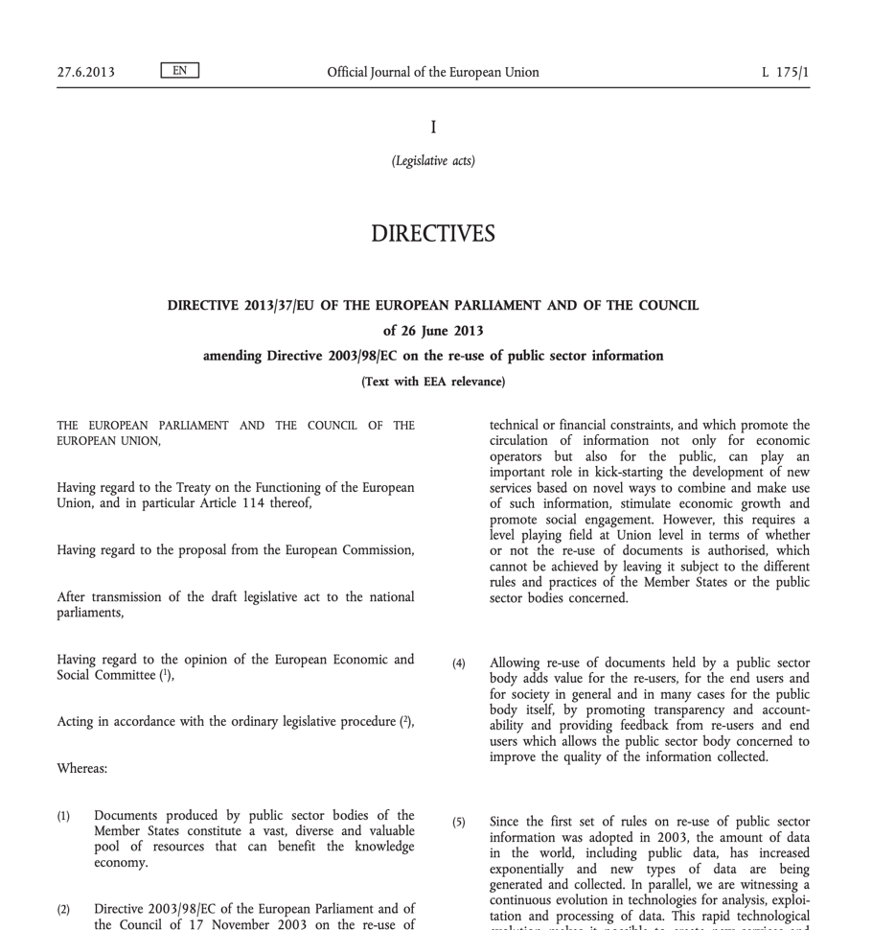
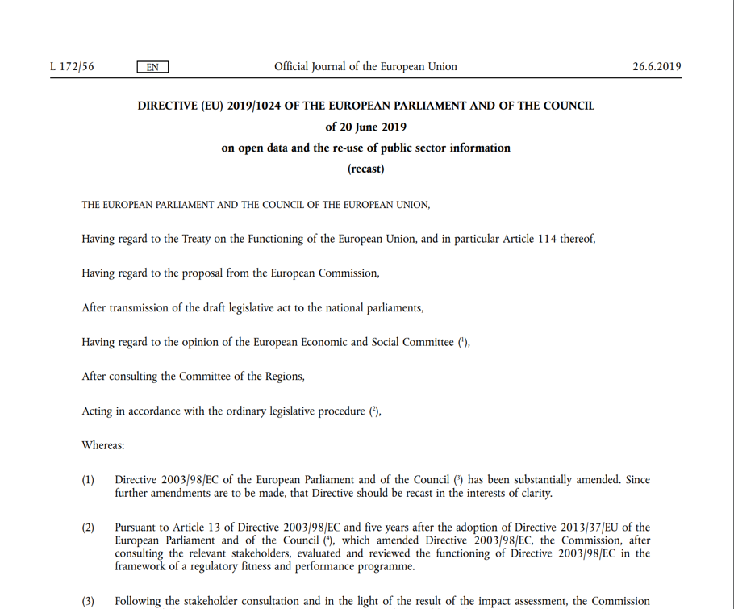
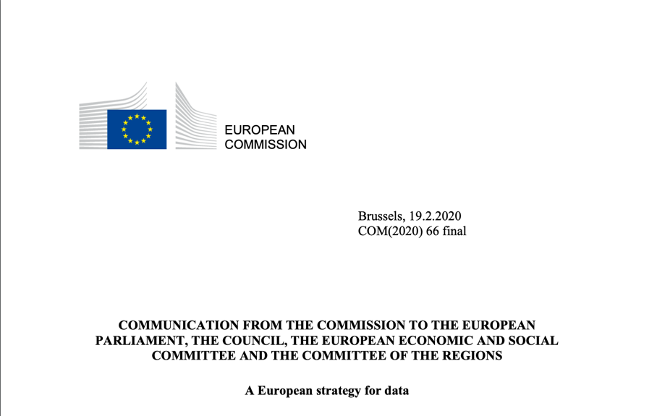
2003
2013
OPEN
2019
OPEN
2020
SHARED!
OPEN
Notes:
The European Union and data publishing and distribution have history. Since 2003, the first PSI Directive…
See https://www.europeandataportal.eu/en/news/introducing-new-open-data-and-psi-directive .
The EU Data Strategy is at https://eur-lex.europa.eu/legal-content/EN/TXT/?qid=1593073685620&uri=CELEX%3A52020DC0066 .

Slide 4
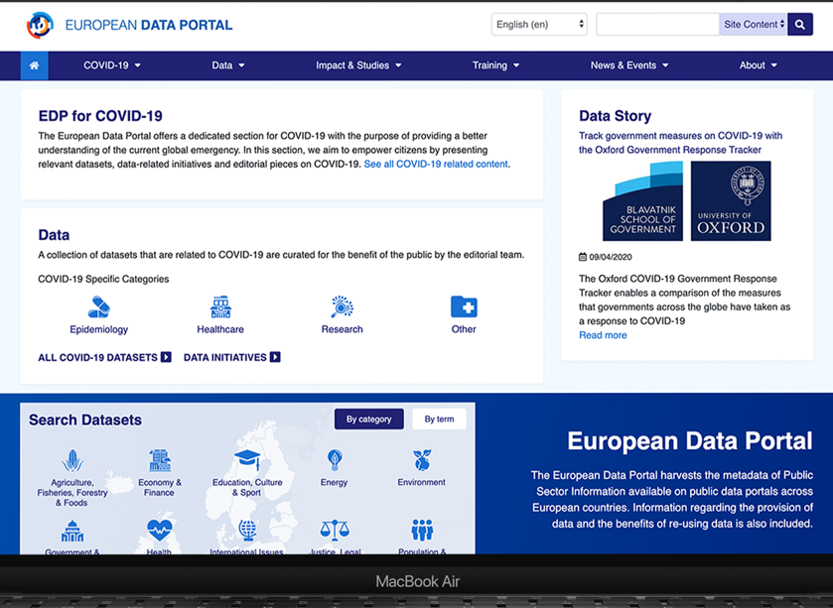
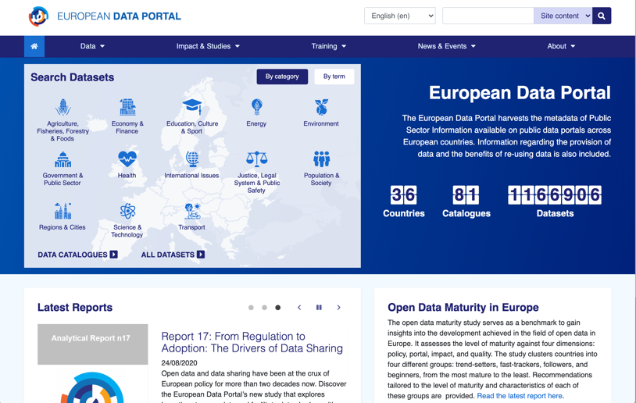
Bringing government data to citizens and unleashing its value
The European Data Portal
Working with the Member States to offer citizens a one-stop shop to discover and access the countries’ and the Union’s data
Providing support to civil servants to publish more and better data
Developing original research to understand and document the value of open government data and resources
Engaging with the public to inform and enable them
https://EuropeanDataPortal.eu @EU_DataPortal

Slide 5
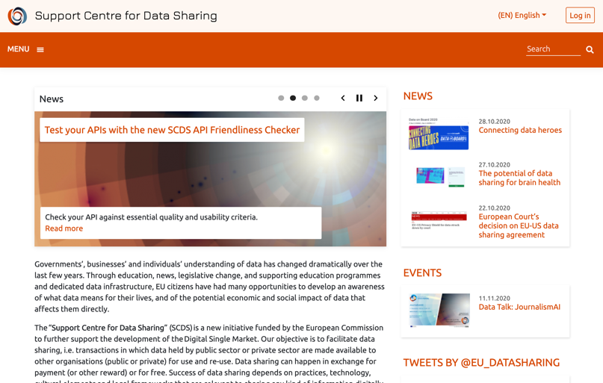
Supporting legal, technologically sound and secure data sharing across organisations
The Support Centre for Data Sharing
https://EUDataSharing.eu @EU_DataSharing

Slide 6
“Data spaces”: what are they?
The reference architecture model for an industrial data space consists of four complementary sub-architectures. It presents a blueprint for safe data exchange and the efficient combination of data and can be configured for each individual case.
Image courtesy International Data Spaces Association, https://www.internationaldataspaces.org/the-principles/#datavalue

Slide 7
“Data spaces”: why do we need them?
The ambition of an efficient data space is to enable a “self-determined control of data flows”.
Image courtesy International Data Spaces Association, https://www.internationaldataspaces.org/the-principles/#datavalue

Slide 8
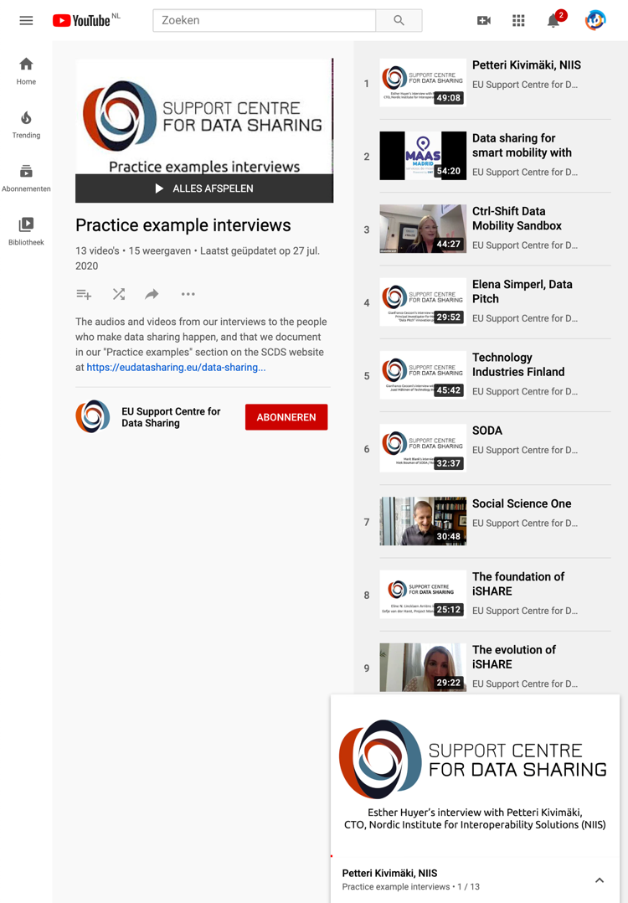
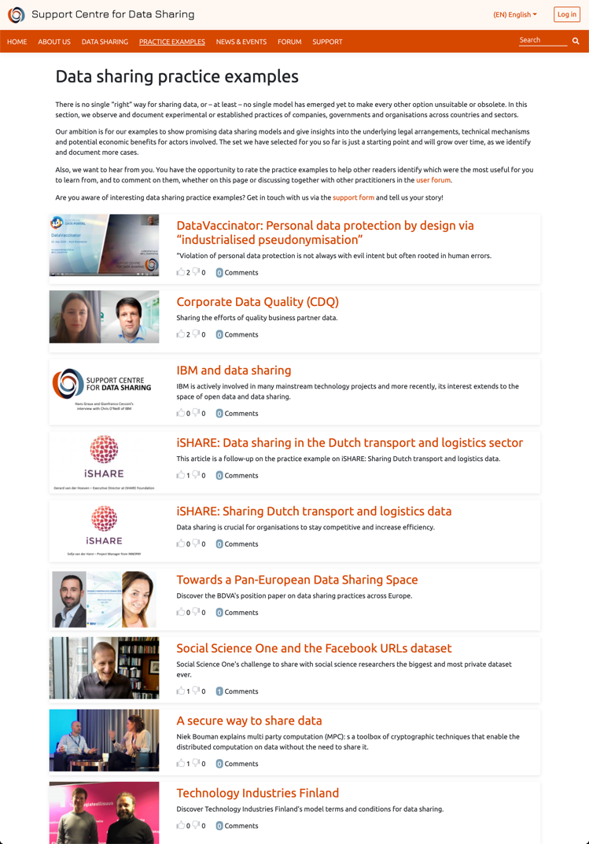
Real-life sharing practices from leading EU and worldwide organisations
Data sharing is not yet a consolidated practice
Learning from practitioners is among the best opportunities available to explore and choose what models work for us
SCDS offers interviews and analysis from data sharing practices, projects and organisations across industries and public sector
Most are available as videos, too
Coming soon: more of it!

Slide 9
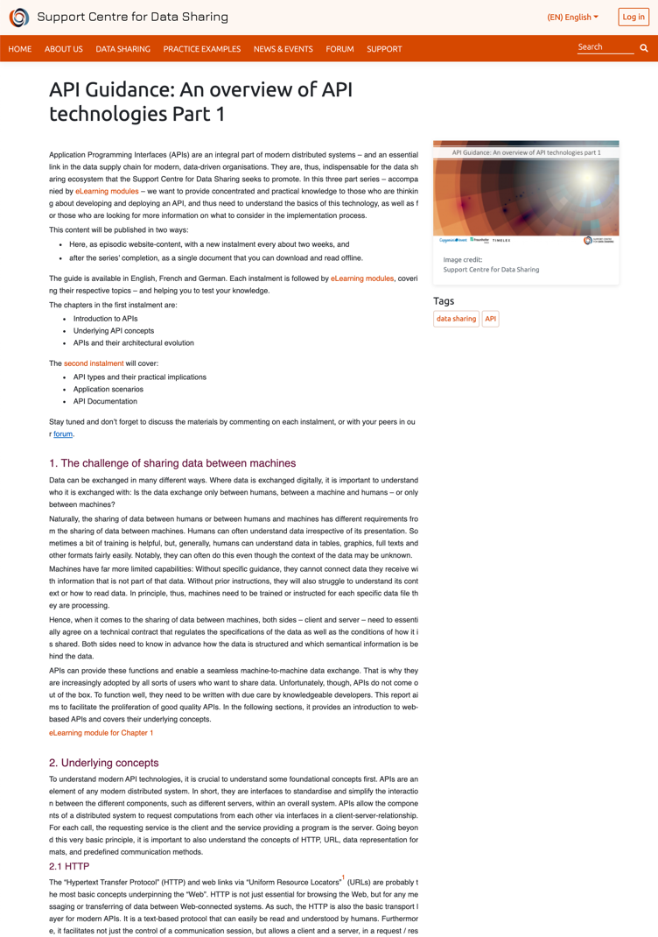
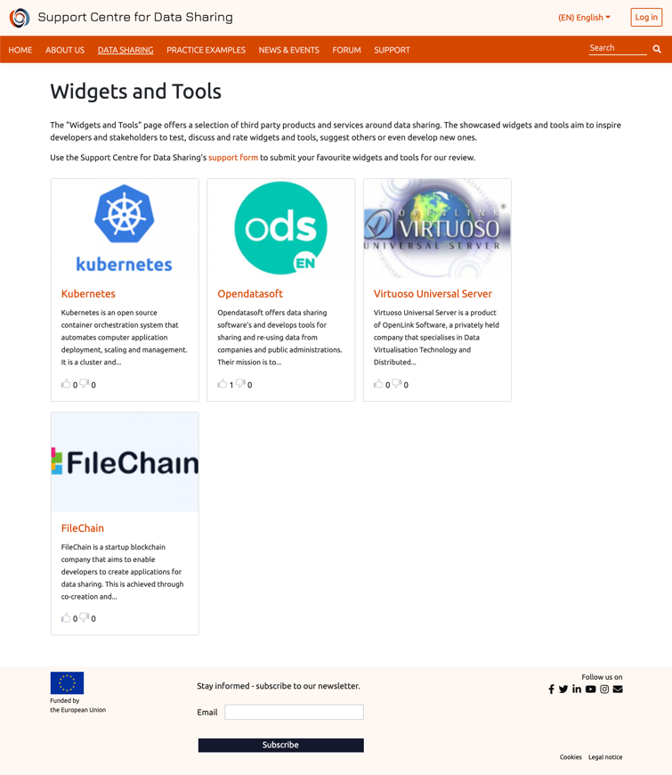
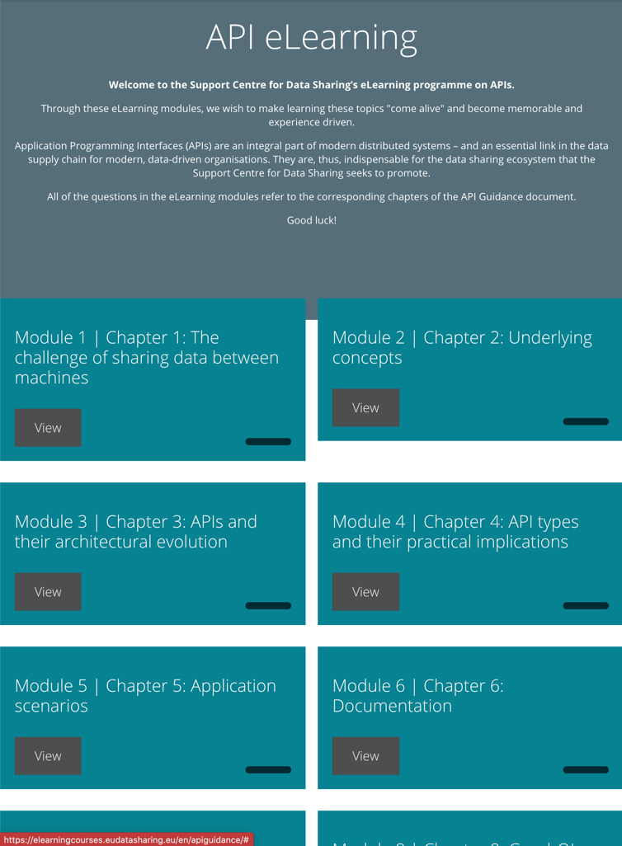
Technology advice and learning
Technologically sound and secure practices are integral to data sharing
SCDS offers guidance and advice, from the basics of API use, to security, to the review of widgets and tools available to learn and explore, to e-learning
Coming soon: coverage of the most advanced – and still not mainstream – topics, such as data provenance and lineage
Notes:
The icon is “technical by Gem Designs from the Noun Project“

Slide 10
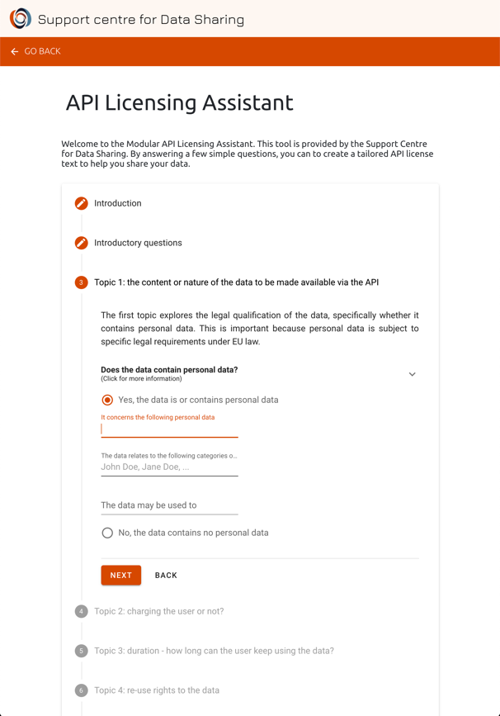
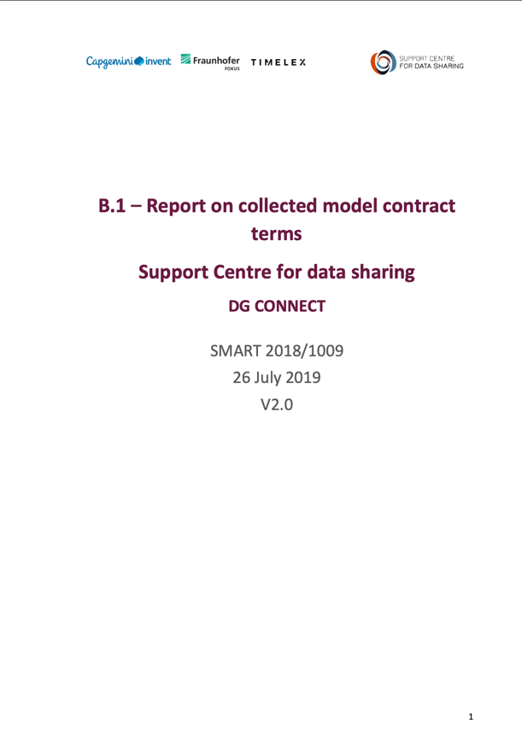
Tools to take your first, solid steps towards sharing
A significant part of data sharing model are the legal setting in which they take place: the countries’ legal framework and the sharing agreement between the parties
SCDS offers reference analysis of the applicable EU law, and of the mainstream contract terms being used “in the wild”
Tools such as the Licensing Assistant support you in writing a basic sharing licence
Coming soon: EU-recommended contract terms
Notes:
The icon is “legal“ by Gem Designs from the Noun Project“

Slide 11
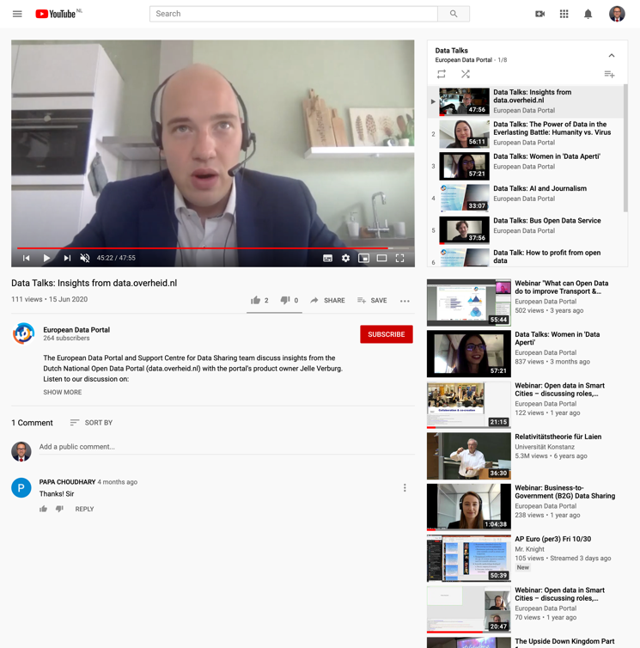
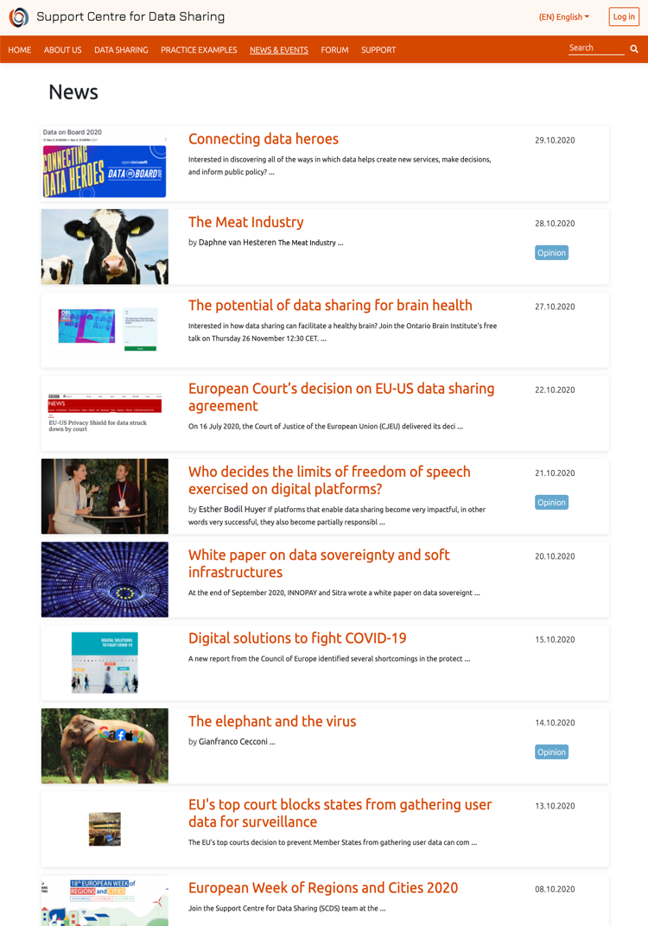
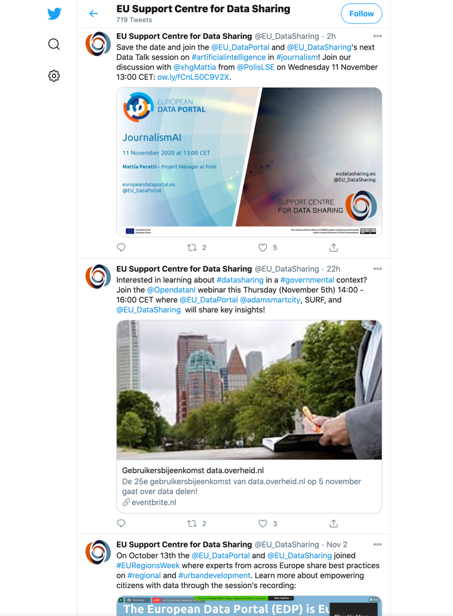
An up-to-date outlook of what is happening in the community
So many news around data sharing, in EU and worldwide. SCDS helps you orient yourself
Opinion pieces by guest contributors and our team challenge you on the more complex topics
Join the live “Data Talks” video podcasts to learn about the protagonists of open data and data sharing, and offer your questions
Follow us on social media to stay up-to-date (@EU_DataSharing on Twitter)
Notes:
The icon is “Globe” by Gem Designs from the Noun Project

Slide 12
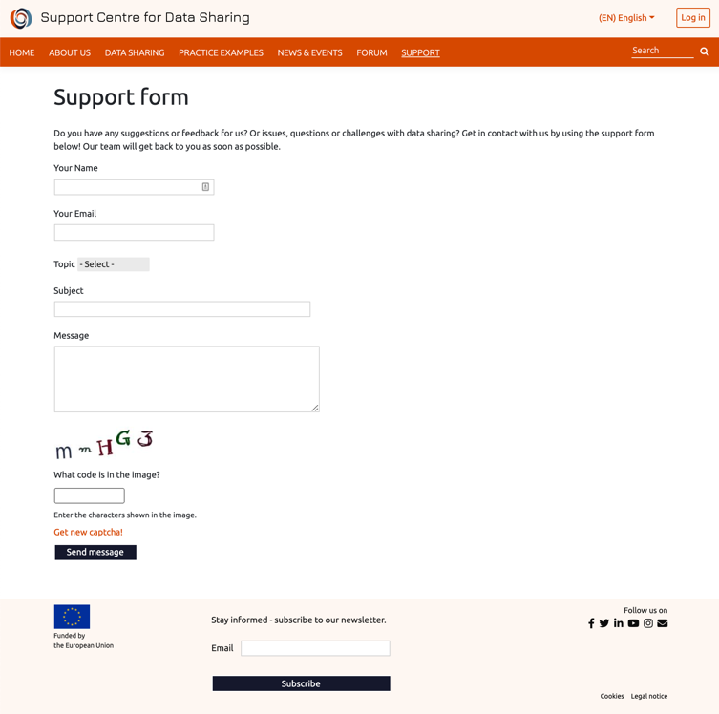
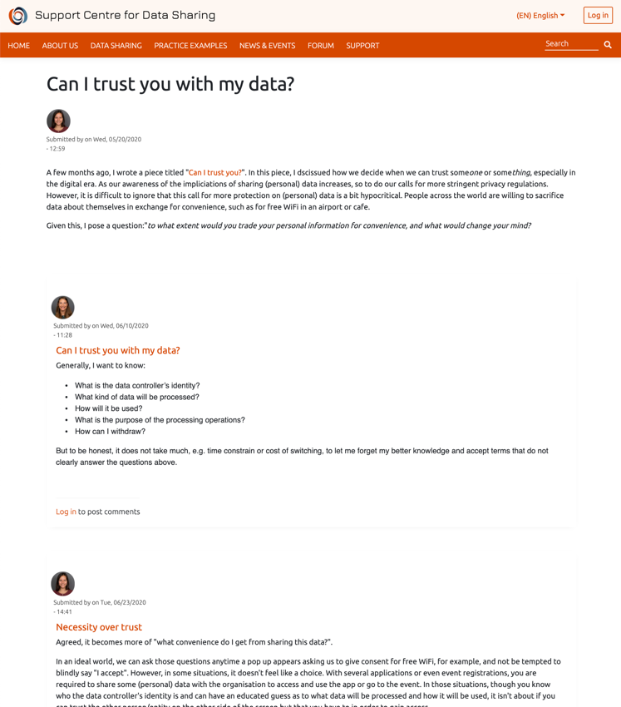
A space for the community to meet and be supported
The community is still learning, practitioners need to support each other
SCDS’ public forum offers a space where practitioners can meet and share their experiences and challenges
When a topic cannot be dealt with in public, submit your request to the team and receive confidential support
Notes:
The icon is “Community by Gem Designs from the Noun Project“

Slide 13
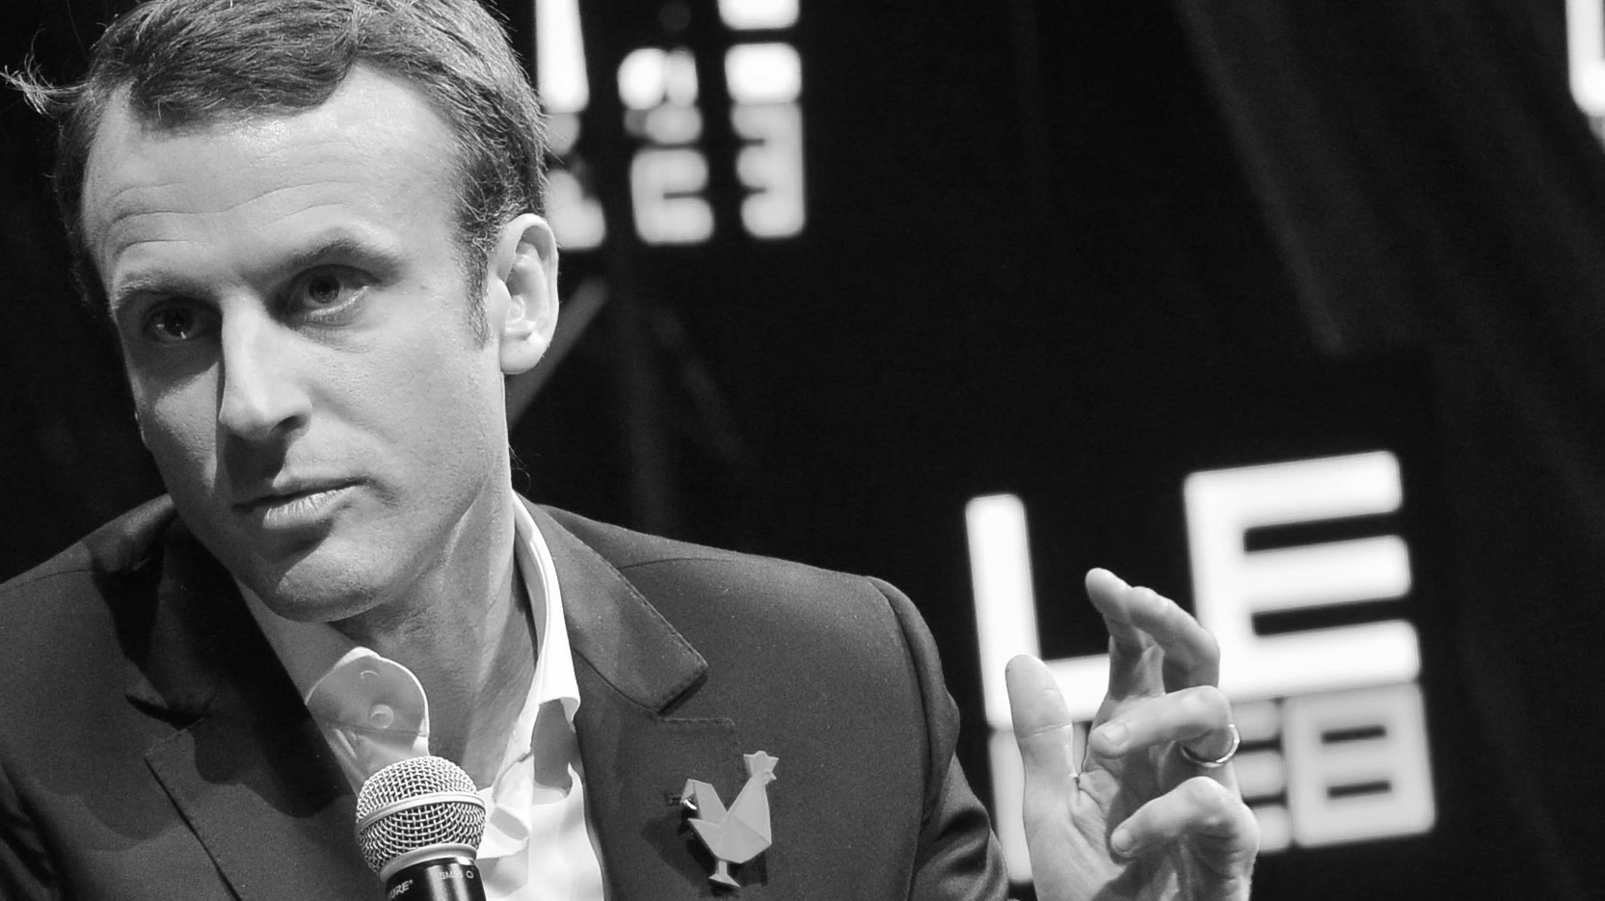
“... we need to build a free, open and safe Internet, enabling the access of all, but also ensuring that our values and our ideals are respected…”
United Nations’ Internet Governance Forum 2018, speech by France president Emmanuel Macron
(C) 2014 Official LeWeb Photos, https://flic.kr/p/q61FEY

Slide 14
THANKS Gianfranco Cecconi EU Support Centre for Data Sharing @EU_DataSharing

