Slide 1

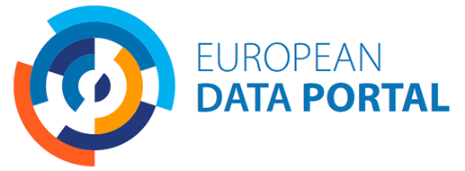









New horizons for open data-driven transformation
Gebruikersbijeenkomst data.overheid.nl, Den Haag, 23 November 2018
Gianfranco Cecconi
@EU_DataPortal
Notes:
My name is Gianfranco Cecconi. I lead the consortium that since 2014 runs for the European Union the – so called – “European Data Portal” or “EDP”. It’s the EU’s largest programme for the promotion of open data across Europe and beyond. We do this work with a bunch of great partners, from technology integrators like Intrasoft International and Fraunhofer Fokus to academic institutions such as the University of Southampton, or legal firms specialised in digital like Time-Lex. I work for Capgemini Invent: the management consulting part of Capgemini.

Slide 2

The EU European
Data Portal Programme
The state of open data
in Europe in 2018
The technology of EDP,
and where we’re going next
Ask not what EDP
can do for you…

Slide 3
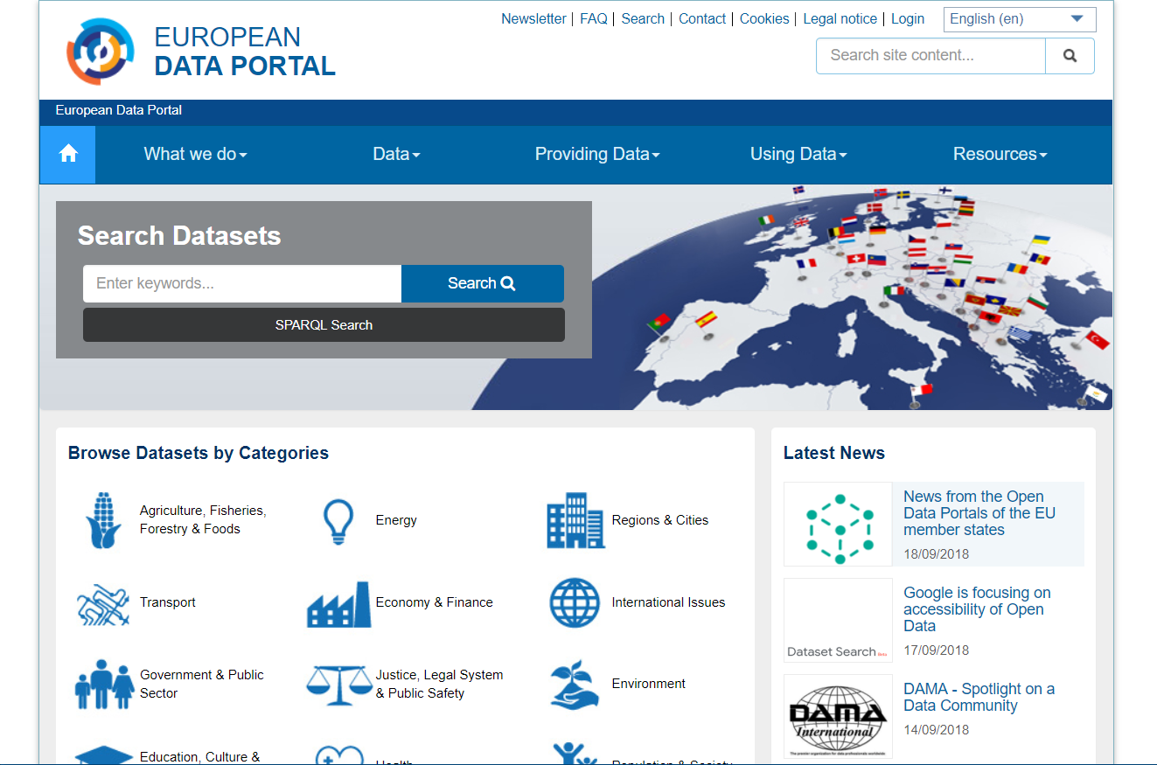
https://www.europeandataportal.eu
Notes:
… and the EDP actually looks like a portal, but the website is actually the tip of the iceberg. In a way, the name of our programme represents well the time it belongs to, when open data was all about getting the data out, getting it published, and then someone, out there, probably in the private sector, will do their magic and everything will be fantastic.
Luckily, over time, we’ve learned to realise how the picture is much more complicated than that.

Slide 4





The team
EU Publications Office
EU DG Connect
Notes:
Summary of partner profiles, sourced from the respective websites and shortened / paraphrased ~25-9-2018.
Capgemini Invent (was Capgemini Consulting) is a business line in Capgemini that focus on helping business leaders plot a path to the future and provide the right vehicle for getting there. Capgemini Invent combines, under one brand, the multi-disciplinary strengths of Capgemini Consulting and key expertise in technology and data science from the rest of the Group, with recent acquisitions of customer engagement firm LiquidHub, innovation consultancy Fahrenheit 212, and its three creative design agencies Idean, Adaptive Lab and Backelite.
Intrasoft International is an IT Solutions and Services Group with strong international presence and expertise, offering innovative and added-value solutions to a wide range of international and national public and private organizations. Its expertise and strength lie in undertaking and delivering, complex, mission - critical projects. Its professionals have developed the ability to combine their technical expertise with thorough understanding of each customer’s individual business needs.
Fraunhofer FOKUS explores and develops the networked world – making it secure, reliable and trustworthy. By the year 2020, 20 billion –connected devices will be in private homes and businesses. This development will fundamentally change communication and interaction in all areas of life and work, from highly automated driving and new entertainment options to smart cities and the factory of tomorrow. Digitalization should ensure a higher quality of life, more sustainability and more security. To achieve this, devices have to be connected – but so does (almost) everything else: people, things, systems, processes and organizations.
Con Terra integrates intelligent Geo-IT solutions into the IT structures of customers in the private sector and public administration agencies. This enables geoinformation to be put to profitable use, making company processes sustainably more efficient, cheaper and more transparent. Con Terra cooperates with universities, participates in research & development projects and standardisation procedures, and plays an active role in committees and working groups of such organisations as ISO, GDI-DE, OGC, and INSPIRE. This puts con terra in a position to evaluate trends affecting the market at early stage and to play a role in shaping and incorporating them in the planning and implementation of IT solutions.
Sogeti is a Capgemini business line focusing on technology and engineering services, offering end-to-end solutions in Digital, Cloud, Testing and Cyber ​security.
The University of Southampton is world-leading university, at 18th place in The Sunday Times Good University Guide 2019 in the top 100 in the QS World University Rankings 2019, based on indicators such as research excellence and employability. It is a research-intensive university, with a strong educational offering, renowned for their innovation and enterprise.
Time.Lex is an allround law firm for the information society. Modern technologies and new media are evolving at the speed of light and legal challenges are matching their pace. The result is that in every branch of law and in every sector, ICT, media and e-regulations are increasingly playing a decisive role. Time Lex aims to be a legal partner that understands these new evolutions.
52°North is an open international network of partners from research, industry and public administration. They foster innovation in Geoinformatics through a collaborative R&D process. Within their network they develop new concepts and technologies e.g. for managing spatio-temporal measurement data and sharing geoprocessing technologies over the web. They evaluate new macro trends, such as the Internet of Things, the Semantic Web or Linked Open Data, and pave the way for unfolding their use in practice.
The Lisbon Council [for Economic Competitiveness and Social Renewal] is a think tank and policy network. Established in 2003 as a non-profit, non-partisan association, the group is dedicated to making a positive contribution through cutting-edge research and by engaging political leaders and the public at large in a constructive exchange about the economic and social challenges of the 21st century.

Slide 5
USE AND RE-USE
ACCESS
DISCOVERY
PUBLISHING
CREATION / COLLECTION
IMPACT
Notes:
These days, I like to describe how the European Data Portal supports the promotion of open data by looking at how we contribute to every stage of the value chain that gets from the creation or collection of the data, to the left, to the moment it actually creates an impact in the world, to the right.
I would like to share this model with you, because I think it may be useful to you, too, to assess where you stand, where your work focuses in open data.

Slide 6
PUBLISHING
eLearning
Tailored support
Promotion of DCAT-AP
Notes:
EDP’s focus starts at the publishing stage. Since the very beginning, the EU asked us to support the Member States in what was the biggest challenge once: liberating the data from its closed systems and publishing.
How did we achieved that? Well, while the EU has been working since the early 2000’s on the policy aspects, e.g. since the first PSI Directive in 2003, we…

Slide 7
DISCOVERY
The portal itself!
Notes:
Then, discovery, that is where the European Data Portal is actually a portal. European data sources or “catalogues” – and the national open government data portals in particular, make their data discoverable trough the EDP. We do not “re-publish” the data, we just make it discoverable, searchable, through making the metadata searchable, and with some technology magic, this works across 25 EU languages, too. E.g. one may search for data about “pollame” – in Italian – and found information about poultry farming and livestock in general. Today, more than 850.000 datasets are offered through EDP from about 80 catalogues.

Slide 8

The data portal
The data discoverable through EDP today
~870.000 datasets | 78 portals from Europe (and beyond!) | ~40 geoportals | 8 DCAT-AP sources
Notes:
Only 8 native DCAT-AP sources because we’re pushing hard in that direction, but it’s growing

Slide 9
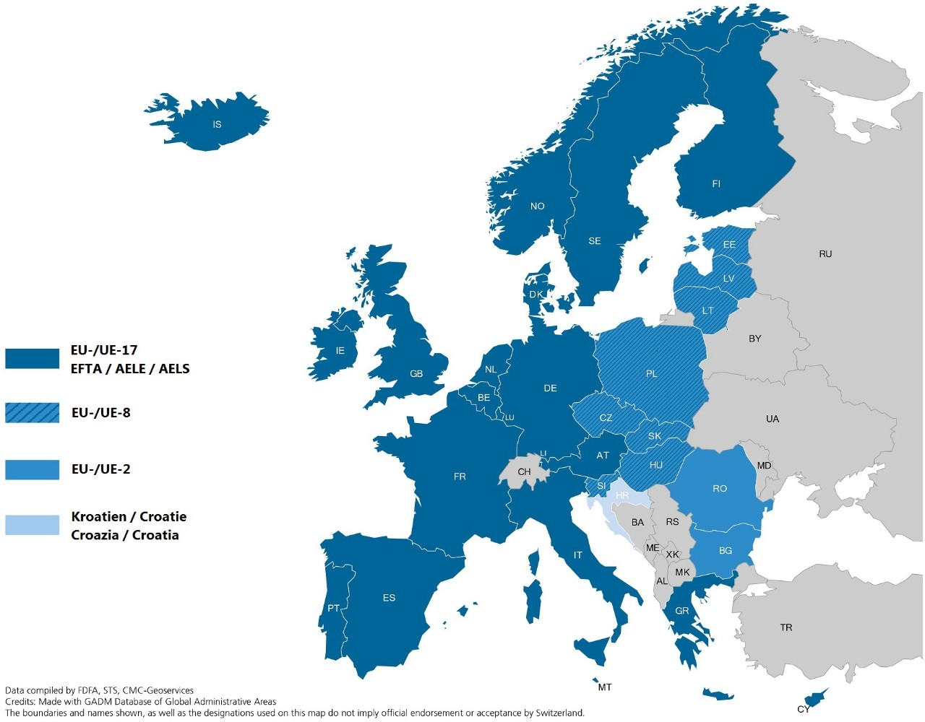
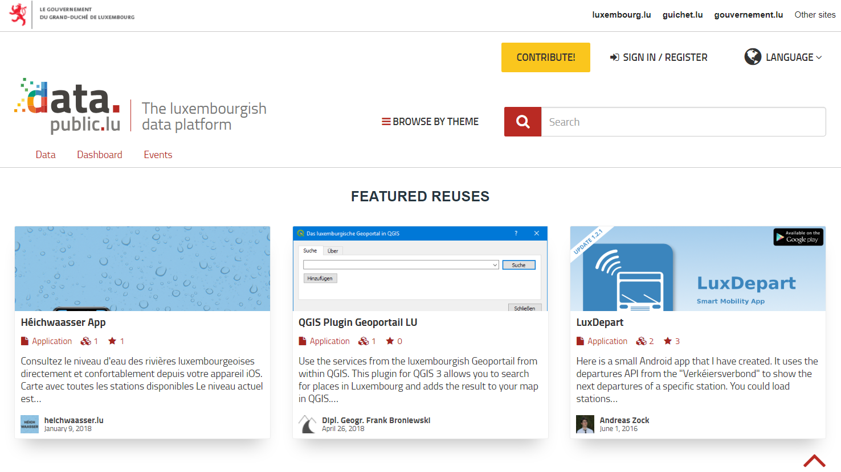
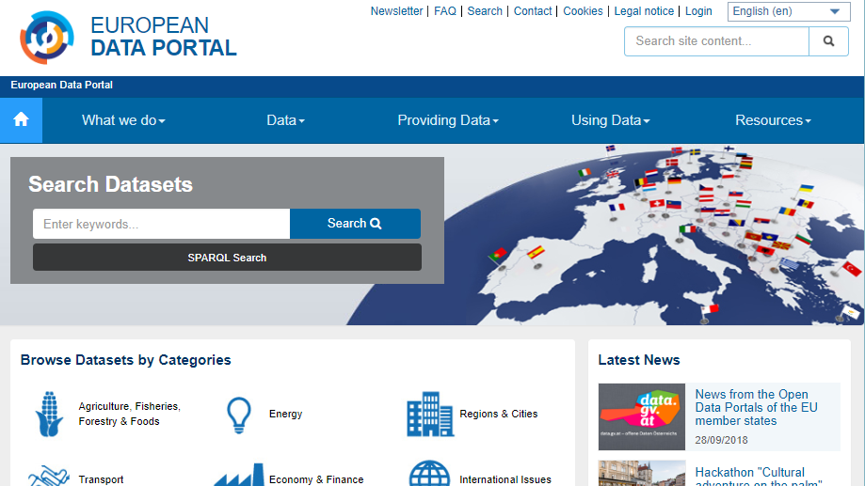
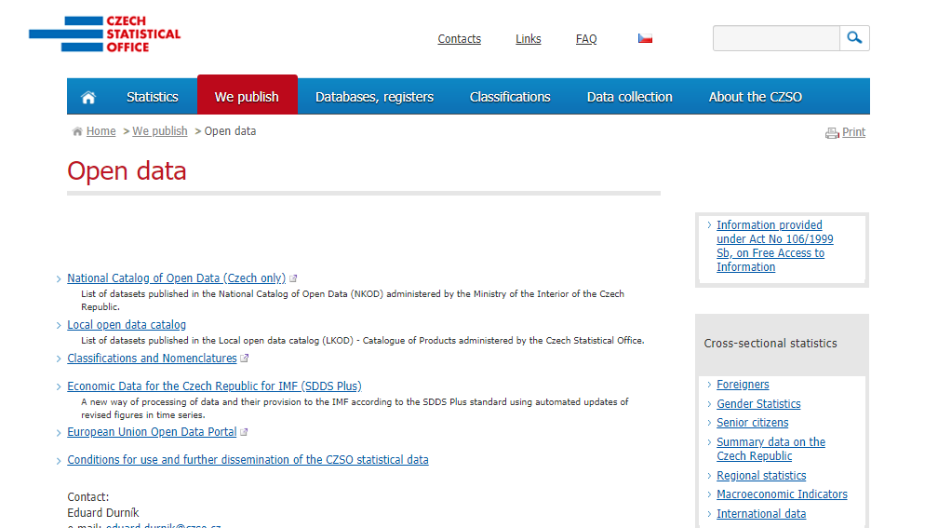
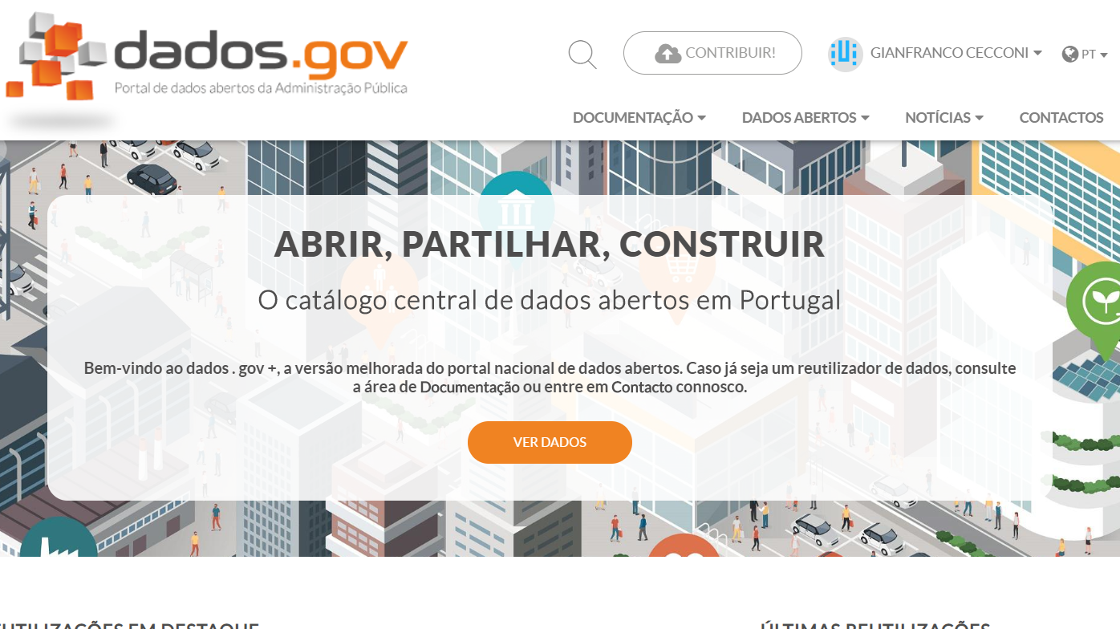
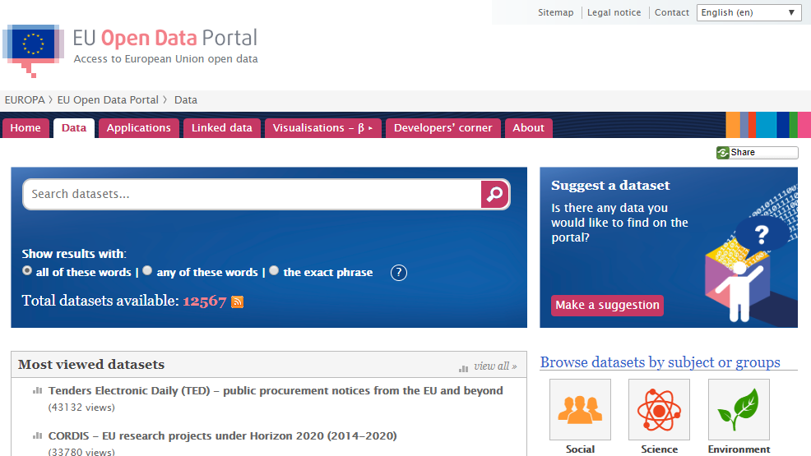
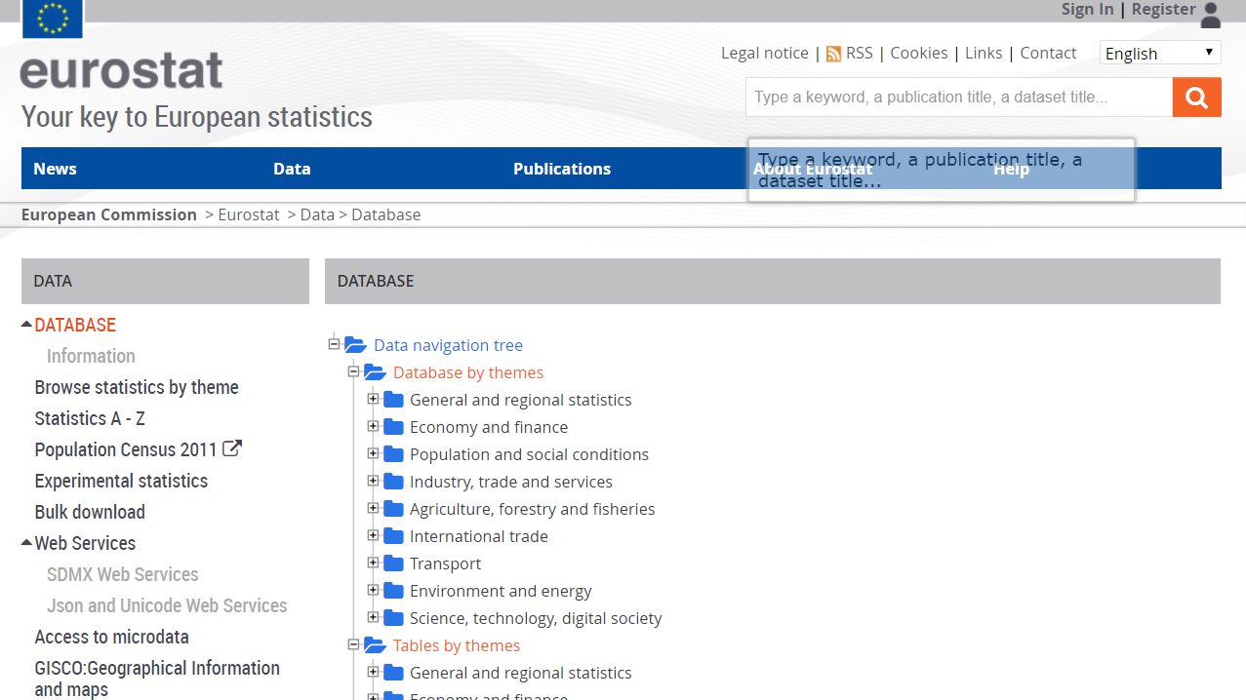
The data portal
How metadata “bubbles up” to the European Data Portal

Slide 10
Welcome,
Google.
Seriously.
®
Welcome to the most exciting and important data marketplace since the Big Data revolution started 25 years ago.
And congratulations on your first search and discovery service dedicated to Open Data.
Putting the right open dataset in the hands of the individual is already improving the way people work, think, learn, communicate and engage with government and civil society.
Data literacy is fast becoming as fundamental a skill as reading or writing.
When we launched the European Data Portal in 2015 it was the first European Union programme for the promotion of Open Data. Today we help thousands of users every day find data, but not only: we provide learning materials, develop research, run support workshops and help invent what’s next for insight-driven governments, NGOs and businesses.
Next year, by enriching our linked data features, we are bringing to life Tim Berners-Lee’s vision for a “web of data”, overcoming the limitations of today’s “web of hyperlinks”.
We are not competitors. We are fully funded by the European Union, we are based in Europe, and we are designed to be fair and balanced and not to have commercial interests. Nonetheless we appreciate you joining us in the massive effort to distribute data to the World. And we appreciate the magnitude of your commitment.
Because what we are doing is increasing social impact by amplifying opportunities for data to be found and used.
Welcome to the task.
Google is a registered trademarks of Google LLC.
Notes:
… and the idea is so good that finally we’re not the only ones! Google recently joined us by launching a beta of what they call the “Dataset Search” service. We are complementary: (…) The more players in this space, the more signs that there is interest for Open Data and there is an audience out there that we need to support at our best.

Slide 11
ACCESS
Tailored support
Notes:
The access stage – that is the technical terms by which the data is made available to the user – being it download, API etc. is also something we try to develop in the ecosystem…

Slide 12
USE AND RE-USE
Public engagement
Literacy development
News, social media
eLearning
Tailored support
Notes:
Finally, of course, value is increased by the actual application of data to solve a real problem, develop a service, or an application, and re-use.

Slide 13
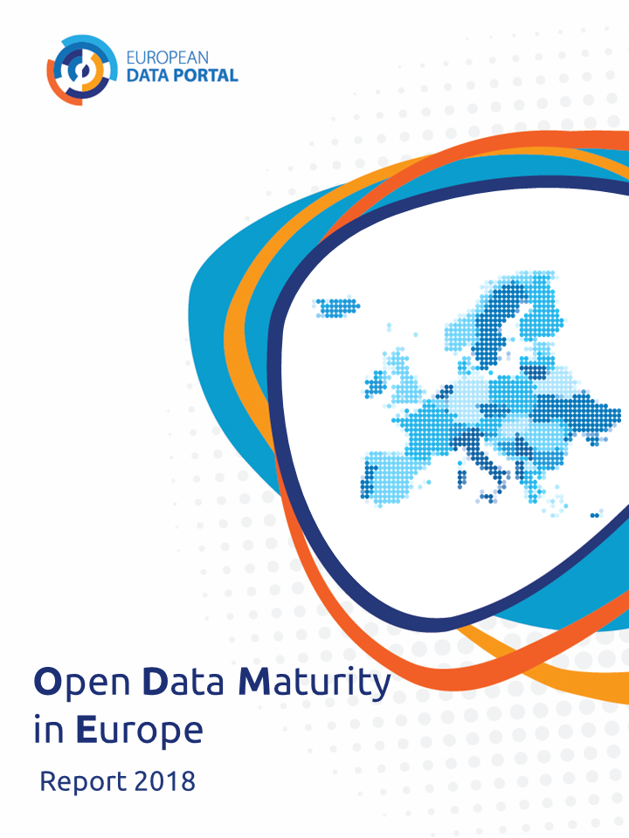
IMPACT
Research
Documentation
of outcomes and use cases
Experimentation
European Data Portal, “Open Data Maturity in Europe 2018” report, 2018, https://www.europeandataportal.eu/sites/default/files/edp_landscaping_insight_report_n4_2018.pdf
Notes:
And finally, impact. Developing the value of open data is not for the sake of itself. It makes sense in the context of a specified problem. We do research in that space, too, and do plan to run experiments. E.g. many of the countries we work with observe anecdotal reduction in freedom of information (FOI) requests following the release of relevant data. We are looking for opportunities to run dedicated experiments to analyse that.

Slide 14
The EU European
Data Portal Programme
The state of open data
in Europe in 2018
The technology of EDP,
and where we’re going next
Any questions?
Ask not what EDP
can do for you…

Slide 15
IMPACT
Research
Documentation
of outcomes and use cases
Experimentation
European Data Portal, “Open Data Maturity in Europe 2018” report, 2018, https://www.europeandataportal.eu/sites/default/files/edp_landscaping_insight_report_n4_2018.pdf

Slide 16
IMPACT
Impact: a marked effect or influence
Notes:
Today, particularly working with countries that can claim to have been successful developing their open data proposition, focus can’t be but on impact.
As we mature, we remember where we came from, that is the key idea that open data can be used to improve lives, make services more effective and efficient, develop the economy, make the relationship between government and citizens healthier.

Slide 17
Why measure impact?
Maintain quality and support
Justify investment
Focus resources where they make the most effect
Benchmarking
Understanding impact
Communicate impact
IMPACT

Slide 18
Challenges of measuring impact
IMPACT
Need for agreement around what
we call “measurement”, “assessment”
and indicators
  … and no common taxonomy in the
  open data community, in general!
Network effects
Intangible / untraceable
Free as in beer
Do we know what we are looking for?

Slide 19
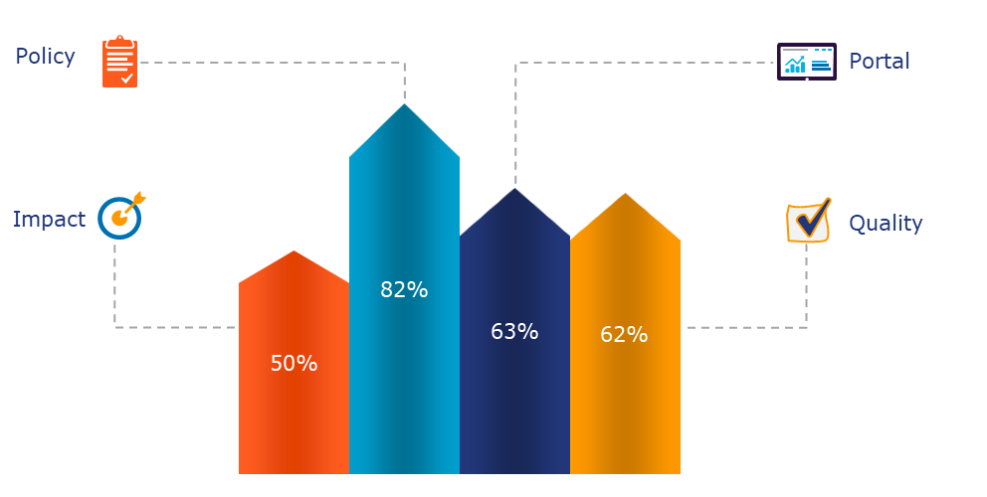
Open Data Maturity report 2018
Overall average maturity scores
European Data Portal, “Open Data Maturity in Europe 2018” report, 2018
https://www.europeandataportal.eu/sites/default/files/edp_landscaping_insight_report_n4_2018.pdf
Notes:
This is the overall picture for Europe. You’ll see that – while we’ve became great on policy and can’t complain for portals and quality, impact…

Slide 20
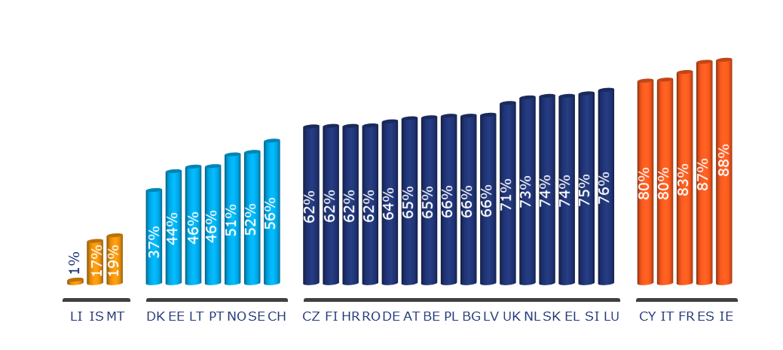
Open Data Maturity report 2018
Member States performance and clusters
European Data Portal, “Open Data Maturity in Europe 2018” report, 2018
https://www.europeandataportal.eu/sites/default/files/edp_landscaping_insight_report_n4_2018.pdf
Notes:
And the Netherlands are doing great: in the top half of what we called the “fast-trackers” cluster: those countries whose achievements and practices…
For reference, the “fast-tracker” definition: Country shows a good level of maturity against all dimensions. Overall the country showcases activities to boost data publication, with a strategic approach to increase the quality of published data and a high level of compliance with existing standards is achieved. The national portal provides a good level of functionalities to cover the needs of advanced and basic users. Limited efforts are made to monitor the impact of Open Data. However a stronger focus is given to tracking and boosting reuse. Some issues can still be observed, with measures in place to tackle them.

Slide 21
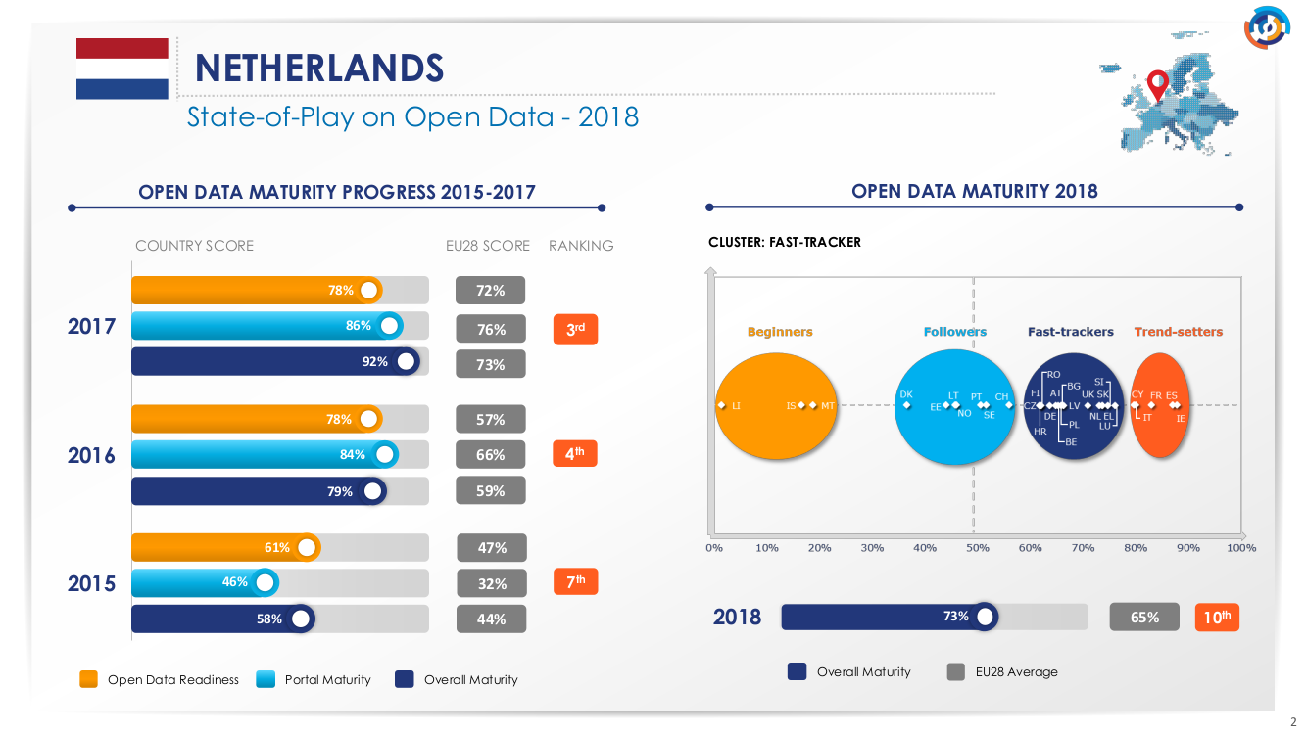
European Data Portal, “Open Data Maturity in Europe 2018” report, 2018
https://www.europeandataportal.eu/sites/default/files/edp_landscaping_insight_report_n4_2018.pdf

Slide 22
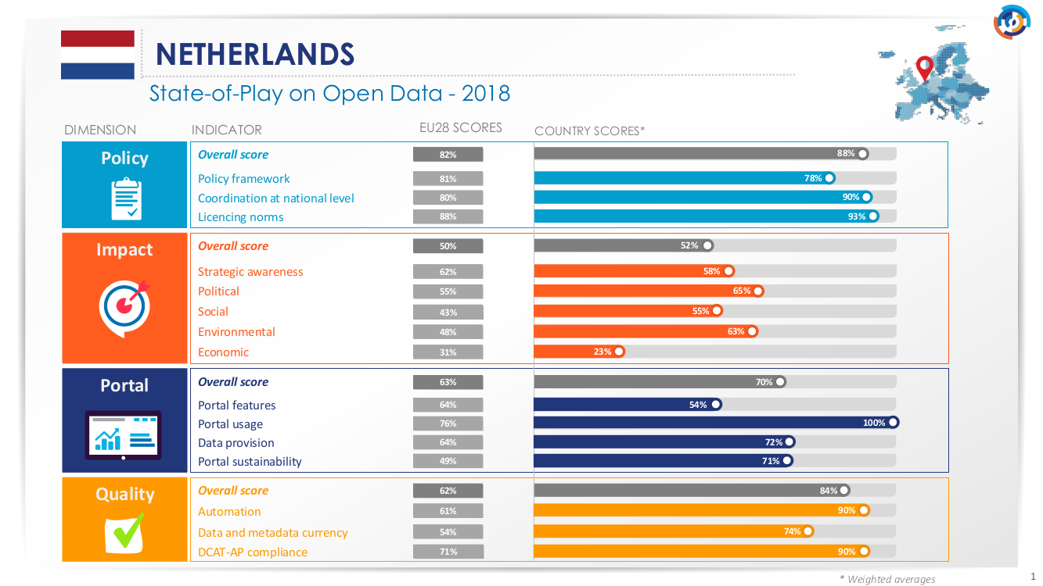
European Data Portal, “Open Data Maturity in Europe 2018” report, 2018
https://www.europeandataportal.eu/sites/default/files/edp_landscaping_insight_report_n4_2018.pdf

Slide 23
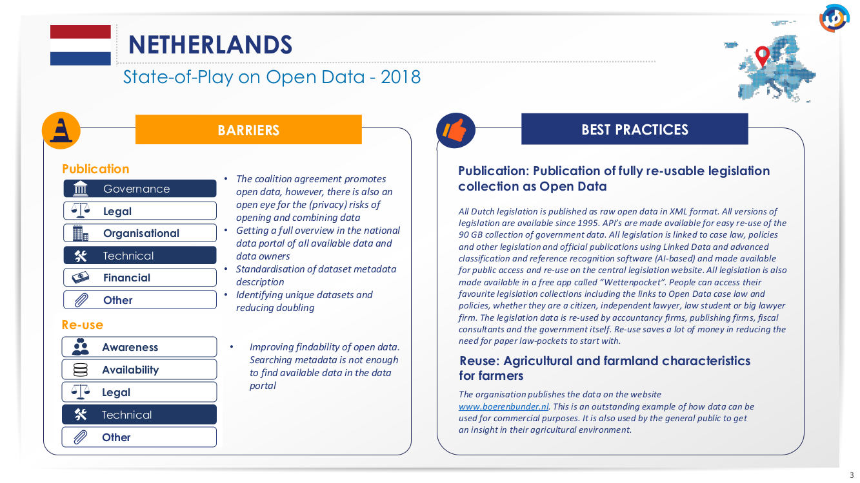
European Data Portal, “Open Data Maturity in Europe 2018” report, 2018
https://www.europeandataportal.eu/sites/default/files/edp_landscaping_insight_report_n4_2018.pdf

Slide 24
New horizons
What’s next for the fast-trackers? Time to graduate from traction to impact
1
Assist the development of open data initiatives at local and regional level and coordinate more intensively.
Activate the network of PSI officers and enable them to set up monitoring activities within their organisation. Track progress and assist them.
Ensure that existing open data courses and training materials are promoted and extensively used.
Focus on organising activities that better target the delivery of sustainable solutions. Move away from creativity-stimulating formats (e.g. hackathons) to formats that enable business opportunities for medium to long-term engagement (e.g. data challenges).
2
3
4
European Data Portal, “Open Data Maturity in Europe 2018” report, 2018
https://www.europeandataportal.eu/sites/default/files/edp_landscaping_insight_report_n4_2018.pdf
Notes:
The report concludes with recommendations that we tailored for each of the clusters. Not all of them are necessarily addressing impact but they’re all instrumental to support your development, or maintaining your achievements, as you strive for impact.
Let me give you a short summary of the recommendations for the trend-setters like Ireland.
Full text from the report:
1 - Assist the development of Open Data initiatives at local and regional level and coordinate more intensively with the local and regional Open Data teams.
2 - Activate the network of PSI officers and enable them to set up monitoring activities within their organisation (e.g. develop plans for data publication; monitor charging practices within their organisation). Track progress against these plans and assist PSI officers to alleviate barriers to data publication identified in their organisation.
3 - Ensure that existing Open Data courses and training materials are promoted and extensively used. Cooperate with training organisations to develop new course offerings tailored to the needs of your national, regional and local administrations. Enable such courses to be formally recognised as ‘continuing education’ and provide certification for civil servants upon successful completion. Ensure more financial resources are allocated at all administrative levels to enable more civil servants to benefit from such training activities.
4 - Focus on organising activities that better target the delivery of sustainable solutions. Move away from creativity-stimulating formats (e.g. hackathons) to formats that enable business opportunities for medium to long-term engagement (e.g. data challenges). Ensure funding and political sponsorship (e.g. organisation as ‘patron’) for winning ideas. Promote and follow-up on the performance of developed products and/or services.

Slide 25
New horizons
What’s next for the fast-trackers? Time to graduate from traction to impact
5
Develop strategic awareness of reuse and impact of open data. If necessary, focus your resources on a specified field or sector, to start demonstrating impact.
Update the national open data portal to include features that enable online interaction between data publishers and reusers. Showcase reuse examples prominently on the national portal and promote the datasets used to develop those use cases.
Monitor access and usage of the portal and enhance knowledge in your team around the profiles of your portal’s typical users. Enable such insights to flow into improving the portals features.
Identify the main real-time data holders in your country and incentivise the publication of their data.
6
7
8
European Data Portal, “Open Data Maturity in Europe 2018” report, 2018
https://www.europeandataportal.eu/sites/default/files/edp_landscaping_insight_report_n4_2018.pdf
Notes:
Full text from the report:
5 - Develop strategic awareness of reuse and impact of Open Data. If necessary, focus your resources on a specified field or sector, to start demonstrating impact. Start with data domains defined as high-priority around which a data ecosystem already gained momentum. Pilot thematic workshops in these areas. Create a framework for knowledge exchange and enable the development of a community of practice between publishers and reusers. Increase your knowledge on the publication and reuse of data in that domain and start thinking of a definition of impact in that field that can be operationalised into metrics.
6 – Update the national Open Data portal to include features that enable online interaction between data publishers and reusers. Showcase reuse examples prominently on the national portal and promote the datasets used to develop those use cases. If desired, do not avoid promoting the developers as well.
7 - Monitor access and usage of the portal and enhance knowledge in your team around the profiles of your portal’s typical users. Enable such insights to flow into improving the portals features, the access to data and improve the variety of data published in your country.
8 - Identify the main real-time data holders in your country and advertise for publication of their data. Deepen the understanding amongst real-time data holders of the high value of their data for enabling societal development (e.g. within the broader vision of smart cities and with most of high-value sectors becoming real-time). Understand the concerns and costs of publication and work together with publishers to enable the data publication process. Start with a small range of datasets.

Slide 26
New horizons
What’s next for the fast-trackers? Time to graduate from traction to impact
9
Think of ways to ensure the portal’s sustainability by enabling more contributions from the open data community (in terms of own datasets, developed use cases, news and blog items written by the community), by providing value-added features, as well as by exploring additional funding options.
Enforce minimum standards to quality of metadata and data by using analytics tools to monitor data publication – at both metadata (compliance with the DCAT-AP schema) and data (formats of publication) level. Act on the findings of these reports.
10
European Data Portal, “Open Data Maturity in Europe 2018” report, 2018
https://www.europeandataportal.eu/sites/default/files/edp_landscaping_insight_report_n4_2018.pdf
Notes:
Full text from the report:
9 – Think of ways to ensure the portal’s sustainability by enabling more contributions from the Open Data community (e.g. contributions in terms of own datasets, developed use cases, news and blog items written by the community), by providing value-added features, as well as by exploring additional funding options.
10 - Enforce minimum standards to quality of metadata and data by using analytics tools to monitor data publication – at both metadata (compliance with the DCAT-AP schema) and data (formats of publication) level. Develop validation schemas for your national portal and send out reports on published datasets to data providers. Act on the findings of these reports and provide tailored assistance to publishers to increase the quality of their data publication, both in terms of metadata and data.

Slide 27
The EU European
Data Portal Programme
The state of open data
in Europe in 2018
The technology of EDP,
and where we’re going next
Any questions?
Ask not what EDP
can do for you…

Slide 28
The data portal
High-level system architecture
Notes:
The data catalogue is powered by CKAN + extensions
Version 2.5.x (update planned)
ckanext-spatial
Solr 6.1.0 (Update planned)
Custom CKAN extension was developed to integrate EDP-specific functionality
https://gitlab.com/european-data-portal/ckanext-edp
All other content is offered through a Drupal CMS
Third-party services, e.g. YouTube https://www.youtube.com/channel/UCWRxmFRYBSQyUe6GFOOrxFA , Twitter, LinkedIn...

Slide 29
The data portal
CKAN extension overview
I18N
Custom translations of static content
Schema and Solr Extension to handle multiple languages
DCAT-AP
Extension of CKAN schema for DCAT-AP
Integration of Virtuoso triplestore
Custom template for EDP visual identity
Statistics
Integration
Misc
Integration of Translation Middleware
Frontend tweaks
Generate statistical data about the data catalogue
MQA information
ECAS login
Vocabulary resolution
Visualisation tool for tabular data and geo data
schema.org integration
Licensing Assistant Integration
Template
Provision of illustrations
XLSX generation
Advanced ATOM feed
Geo autocomplete with gazetteer
Similarity feature
Notes:
Worth noting in the narrative:
All CKAN data is also put in a triple store (Virtuoso)
ECAS is the EU SSO service
About DCAT-AP https://joinup.ec.europa.eu/release/dcat-ap-v11

Slide 30
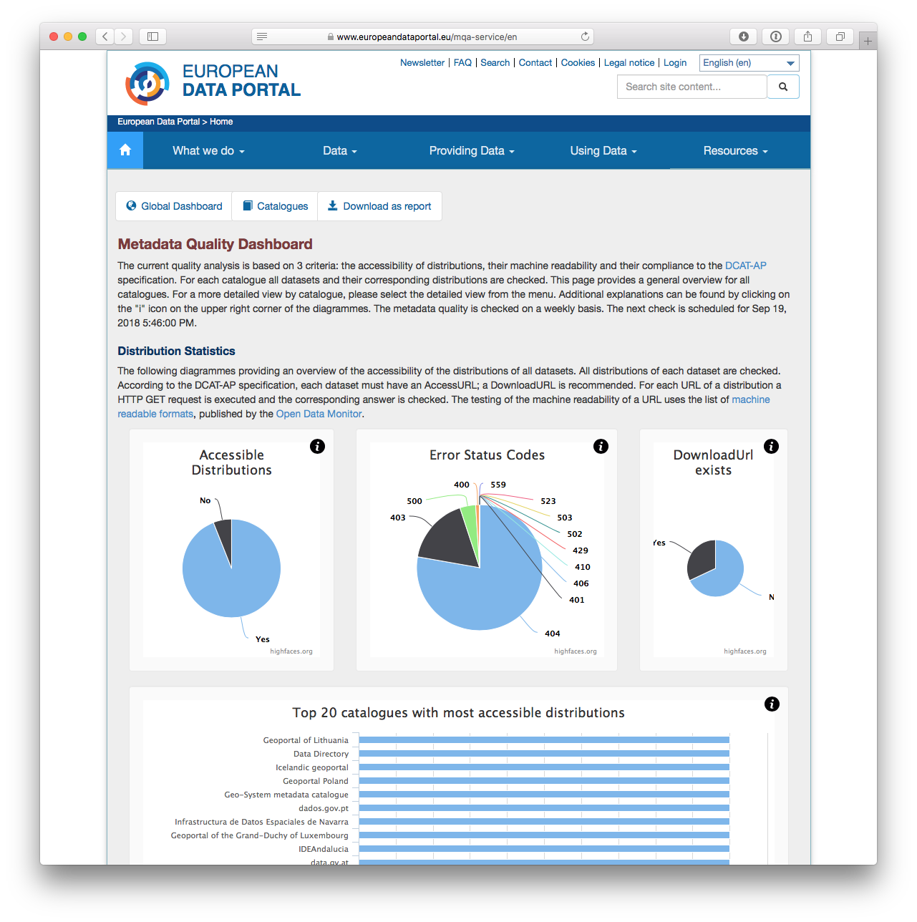
More than your usual data portal
Metadata Quality Assurance (MQA)
Checks metadata quality of each dataset
Publishes results
Generates reports
Shows harvester information

Slide 31
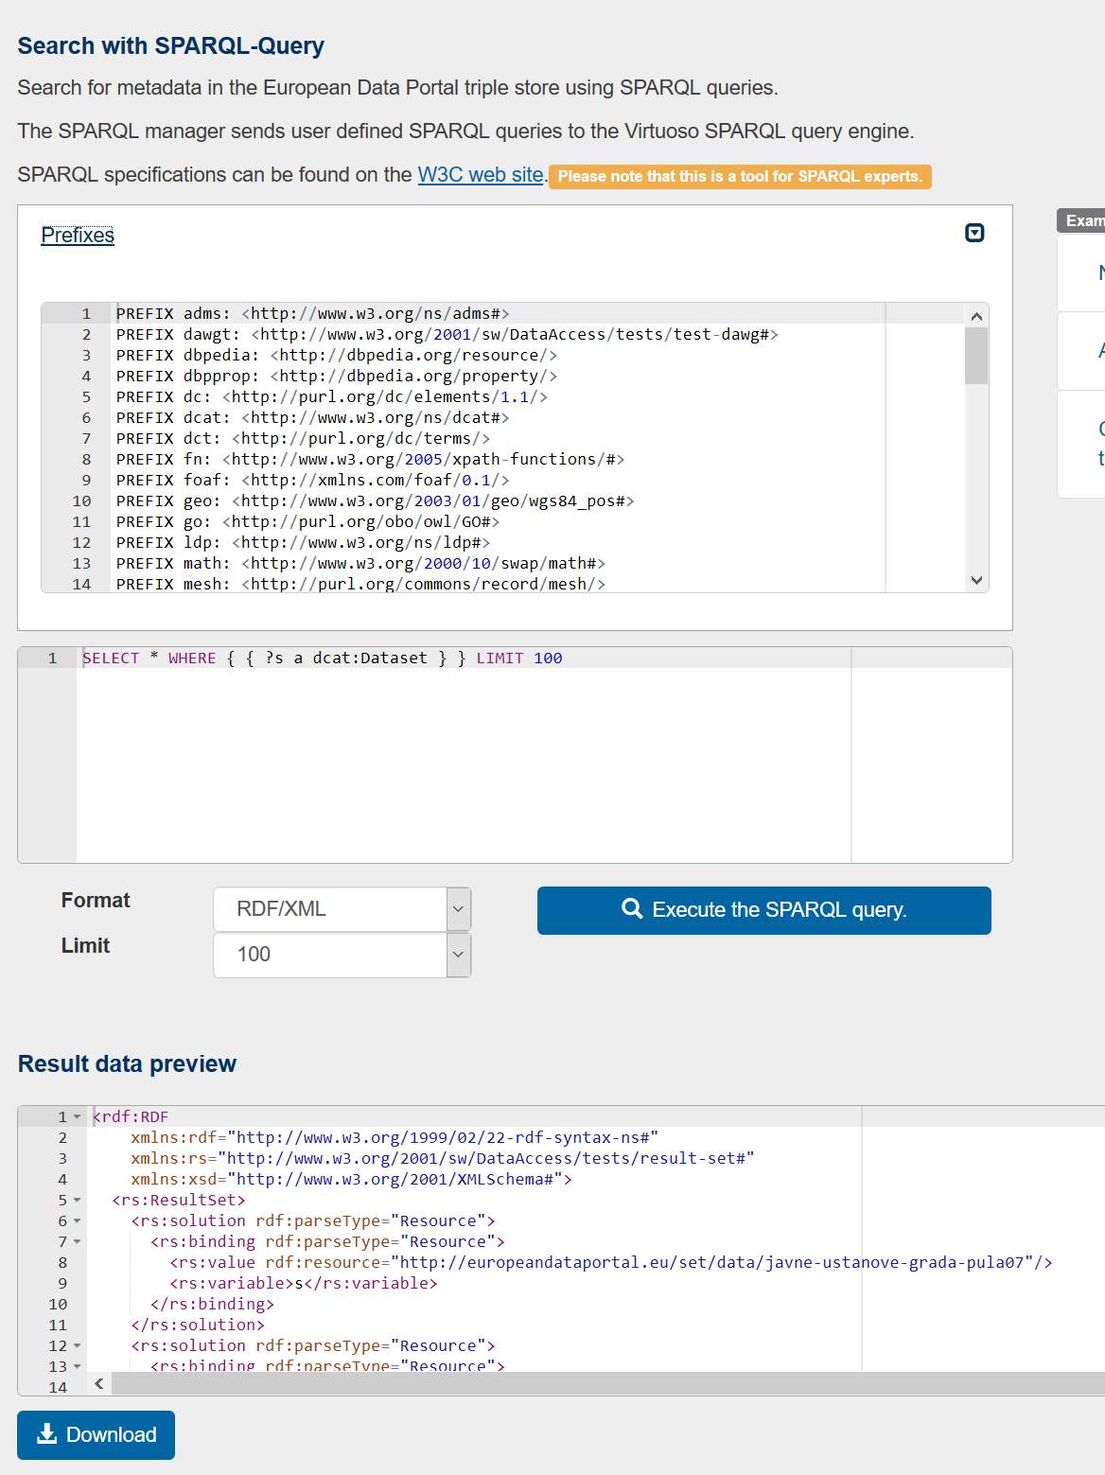
More than your usual data portal
SPARQL query manager
SPARQL Manager offers an assisted access to the Triplestore, hence the DCAT-AP data
Different output formats can be set (XML, JSON, CSV)
Results can be downloaded
Visually query editor
Save and share your queries
Scheduled execution of queries

Slide 32
More than your usual data portal
Automated translation of metadata
EDP
Offering text description of open data in 27 languages
Using the eTranslation Service of the EU Commission
From 1 original language to 26 target languages
CKAN
Translation
Middleware
eTranslation
EU Commission
Notes:
Translating the metadata only, quality is insufficient for the time being for richer text
Often the text is wrong at source, or in a different language than expected

Slide 33
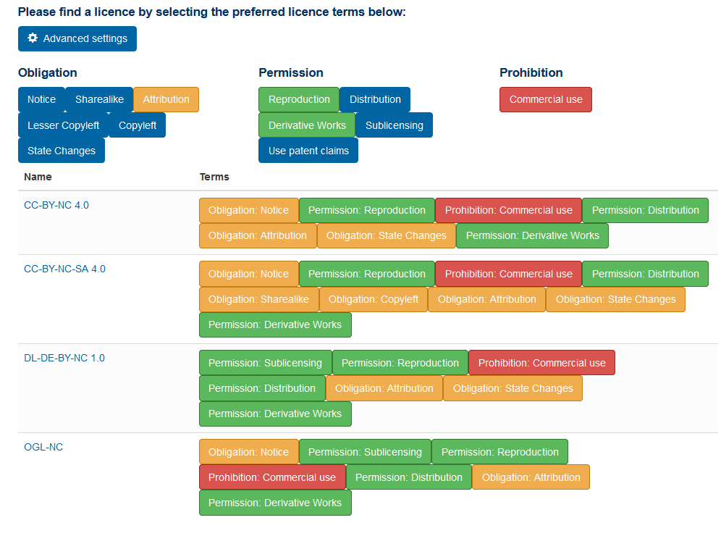
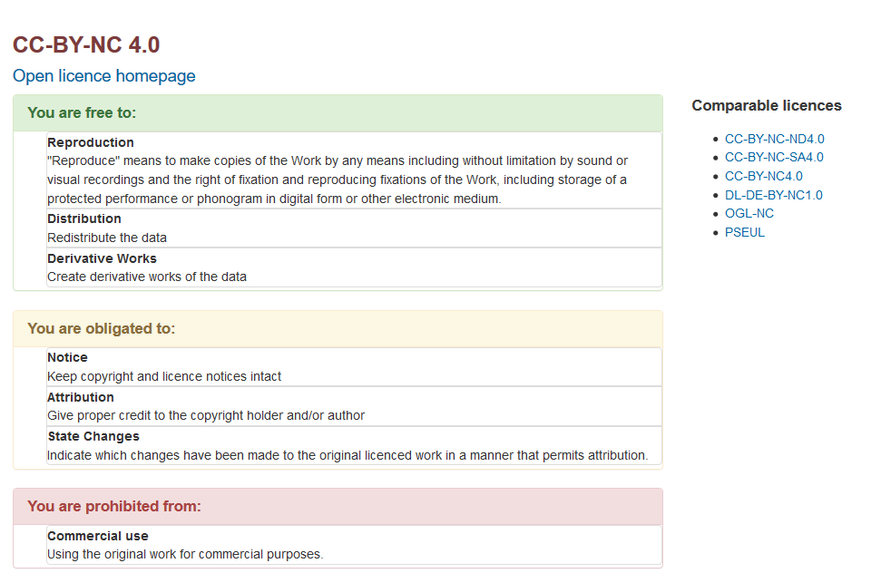
More than your usual data portal
Licensing assistant
Notes:
Based on a Open Data Licenses Ontology, modelling licenses in 12 legal characteristics
Provides easy understandable summaries of Open Data licenses
Provides a list of compatible licenses for a selected one
Recommends licenses with the selected by the user attributes
https://gitlab.com/european-data-portal/licensing-assistant/blob/master/src/main/resources/ontology/od-licenses.owl

Slide 34
Lessons learned
Features
Infrastructure
Dependency on Drupal + CKAN can constrain the product features
  Search, visualisation and dataset detail feel outdated.
  Retro-fitting a Linked Data paradigm onto CKAN is cumbersome.
EDP lacks a strong channel for end-users to engage, comment and discuss
  See the great experience of France, Luxembourg and Portugal using UData
EDP became a highly service-oriented distributed system
Certain services have to cope with heavy load, while others are only used partially
Peaks should not affect the entire system
A more efficient load balancing is needed!

Slide 35
Lessons learned
Maintenance and monitoring
Deployment
Every virtual machine needs attention regarding update and security issues
Maintenance is an extensive task and slows down the development process
Backup and migration processes between infrastructures are demanding
User management on VMs is not straight-forward (SSH etc.)
Each VM needs to be monitored
More convenient maintenance practices are needed
EDP employs 3 deployment stages
Test, Pre-Production, Production
Deployment is partially manual and needs to be conducted on all three stages
An automated and stream-lined deployment mechanism is needed

Slide 36
Lessons learned
Harvesting and catalogue
MQA
In general: the quality of metadata is still low
Basic properties are not set, dead or no resources
Non-conform serialisation formats
Creating and maintaining sufficient transformation rules is an extensive and cumbersome task
CKANs JSON-Schema is not an appropriate format to encode and store Linked Data
Updates in the source portals do not reflect quick enough
Facetted and keyword-based search do not always lead to appropriate search results
Dataset catalogue and MQA reports are sometimes not in sync
An entire validation run takes around two weeks
Checking availability of distributions is an extensive and blocking task
Usage of MQA seems not clear
Information boxes and help texts sometimes do not help
Meaning of metrics is not always easy to understand
Metadata quality has increased since launch and the level of detail is not relevant anymore

Slide 37
Lessons learned
DCAT-AP: pros
DCAT-AP: cons
DCAT-AP gives a clear structure and guideline for harmonising Open Data
It is very consolidated and reuses existing specifications as much as possible
Defined namespaces and vocabularies increase interoperability
  E.g. Metadata Registry of the
  EU Publications Office
In comparison with other Linked Data vocabularies it is (almost) simple and easy to understand
RDF supports multi-lingual data natively
The overall adoption of DCAT-AP is progressing slowly
Many data providers and developers are still overwhelmed by Linked Data and RDF
More pre-defined vocabularies are needed
The specification is in a few points not detailed enough and leaves too much room for interpretation
Clear implementation guidelines are missing

Slide 38
What’s coming (or “version 2.0”)
Conceptual architecture
RESTful API
RDF/XML
JSON-LD
JSON
Content Negotiation
Conversion
(e.g. JSON-LD to Turtle)
RDF Creation
(JSON to Turtle)
Validation / Curation
(e.g. SHACL, Graph Creation)
Document Creation
Virtuoso Triplestore
Elasticsearch

Slide 39
What’s coming (or “version 2.0”)
Features
URI Management
  Design a consistent and meaningful URI schema for catalogues, datasets and distributions
Quality Verification
    Employ mechanisms for ensuring quality of the Linked Data, e.g. SHACL
Multilingual
  Represent the many translations RDF-conform
Access Management
  Implement fitting access management for Linked Data
Revision Support
  Manage storing of previous versions of the metadata
Performance and Scalability
  Ensure a very high response time
Robustness
  Maintain the consistency of the Linked Data
RDF Creation and Curation Process
  Uploaded metadata needs to be transformed/curated before stored

Slide 40
What’s coming (or “version 2.0”)
Additional formats
DCAT-AP acts as foundation
DCAT-AP.x country extensions will be supported, when feasible (e.g. DCAT-AP.de)
GeoDCAT-AP, for geographical metadata
StatDCAT-AP, for statistical data
W3C Data Quality Vocabulary (DQV), to describe metadata quality
W3C CSV on the Web (CSVW) to provide semantic data about tabular distributions

Slide 41
The EU European
Data Portal Programme
The state of open data
in Europe in 2018
The technology of EDP,
and where we’re going next
Any questions?
Ask not what EDP
can do for you…

Slide 42

Notes:
Image by White House Press Office (WHPO) - John F. Kennedy Presidential Library and Museum, Public Domain, https://commons.wikimedia.org/w/index.php?curid=1393796
Paraphrasing John F. Kennedy’s inaugural address from 1961: ask not what EDP can do for you – ask what you can do for EDP and open data…
See https://en.wikipedia.org/wiki/Inauguration_of_John_F._Kennedy#The_inaugural_address for background and https://www.presidency.ucsb.edu/documents/inaugural-address-2 for the full text.

Slide 43
Can you help?
How we are training the national open data teams
Linked Data (5-6 December)
GDPR workshop (11 December)
What we are currently researching
PSI re-use in the public sector
Business-to-Government data sharing
Impact through controlled experiments
How we are engaging the public
Experimental podcast

Slide 44
Gianfranco Cecconi
gianfranco.cecconi@capgemini.com
@eu_dataportal
Notes:
[closing note, on the lines of]
So, to close, impact is the new horizon for developed open data countries such as Ireland. You’ve got so far and are performing so well, you have now the moral responsibility [wink] to do even more and champion and demonstrate impact. In the spirit of sharing and collaboration I’ve iterated multiple times, I ask you to please put our recommendations to the test and keep in touch with EDP to let us know if they work, if they don’t, if we weren’t clear, if something was missing and so on. I thank you for your attention and hope to meet you again soon.

